Slide 1
I211 – Information Infrastructure II
Lecture 3

Slide 2
Local vs. Global Variables
Variables created inside a function are called local variables. They are only accessible inside the function. Arguments are also local!
Variables created outside of functions are global variables, and exist everywhere. Global variables can be dangerous, so we try to minimize their use! Declare globals below your function definitions.
To change the value of a global inside of a local scope, use the global keyword.
Having a global variable and a local variable with the same name is called shadowing. It’s very confusing, so don’t do it!
Global variables are not a replacement for passing parameters to a function!

Slide 3
Global Example
def add_money(amount):
if amount > 0:
global money
money += amount
print amount, "added to money!"
else:
print "Invalid amount!"
#global variable
money = 100
add_money(-20)
add_money(50)
print "The final value of money is", money
>>>
Invalid amount!
50 added to money!
The final value of money is 150

Slide 4
Keyword Arguments
def division(a, b):
return (a/b)
We can use keyword arguments like this:
division(a=4, b=2) == division(b=2, a=4)
This is what we’re doing with list.sort(reverse=True)

Slide 5
Default Parameter Value
def add_money(amount = 50):
if amount > 0:
global money
money += amount
print amount, "added to money!"
else:
print "Invalid amount!“
add_money()
add_money(30)
We can give parameters default values!

Slide 6
Recursion
Recursive functions make use of their own definitions:
def factorial(num):
if(num == 1): #base case
return 1
else :
return num * factorial(num - 1)
def fibonacci(num):
if(num == 0) or (num == 1): #base cases
return 1
else :
return fibonacci(num - 1) + fibonacci(num - 2)

Slide 7
Working with Files
Opening a file:
text_file = open("filename.txt", "r")
"r" is the access mode. In this case, it’s read.
This creates a file object called text_file.
Closing a file: Always close open files!
text_file.close()

Slide 8
Access Modes
Mode | Description
"r" | Read from a text file. If the file doesn’t exist, ERROR.
"w" | Write to a text file. If the file exists, it is overwritten. If it doesn’t exist, it is created.
"a" | Append to a text file. If the file exists, new data is added onto the end. If it doesn’t exist, it is created.
"r+" | Read and write to a file. If the file doesn’t exist, ERROR.
"w+" | Read and write to a file. If the file exists, it is overwritten. If it doesn’t exist, it is created.
"a+" | Append and read to a file. If the file exists, new data is added onto the end. If it doesn’t exist, it is created.

Slide 9
Reading from Files
We can read an entire file at once:
text_file = open("filename.txt", "r")
file_contents = text_file.read()
print file_contents
text_file.close()
If you hit the Enter key in a text file, it adds a "\n" that’s invisible. When Python reads that blank line, it will read the "\n".

Slide 10
Reading from Files
You can read lines into a list:
text_file = open("filename.txt", "r")
lines = text_file.readlines()
print lines
['Line 1\n', 'This is line 2\n', 'That makes this line 3\n']

Slide 11
Line Cleaning
text_file = open("filename.txt", "r")
lines = text_file.readlines()
for i in range(0, len(lines), 1):
lines[i] = lines[i].strip()
print lines
text_file.close()

Slide 12
Writing to a File
text_file = open("write_it.txt", "w")
text_file.write("Line 1\n")
text_file.write("This is line 2\n")
text_file.write("That makes this line 3\n")
text_file.close() # nothing is saved until
# we close the file!!

Slide 13
Writing to a File
We can write from a list to a file:
lines = ["Line 1\n", "This is line 2\n", "That makes this line 3\n"]
text_file.writelines(lines)
Line 1
This is line 2
That makes this line 3

Slide 14
File Copy
def copy_file(filename_from, filename_to):
file = open(filename_from, "r")
lines = file.readlines()
file.close()
file = open(filename_to, "w")
file.writelines(lines)
file.close()
#testcode
filename_from = raw_input("Please enter the name of the file to copy FROM: ")
filename_to = raw_input("Please enter the name of the file to copy TO: ")
copy_file(filename_from, filename_to)

Slide 15
File Locations
If you just specify the name of the file, Python looks for it in the same directory as the .py file you’re running. You can also specify the path manually:
text_file = open("C:/Users/J/Desktop/filename.txt", "r")
You can use this to get the path to the directory where your .py file is running:
import os
path = os.getcwd()
print path

Slide 16
Exceptions
Using the keywords try and except, we can catch any errors our code might throw, and keep the program running!
try:
num = int(raw_input("Enter a number:"))
except:
print "That wasn't an integer!"

Slide 17
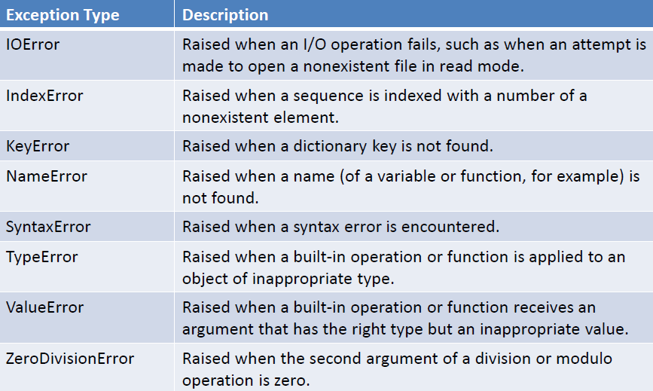
Exception Types

Slide 18
Exceptions
We can also add an else clause:
try:
num = int(raw_input("Enter a number:"))
except ValueError:
print "That is not an integer."
else:
print "Number entered."

Slide 19
Exceptions
So when should we try to catch exceptions?
Opening or writing to a file
Getting user input.
Converting data types
Dividing by a number that could even vaguely possibly be zero. (Did it come from a user?)
Many of the other errors should not occur "spontaneously" – i.e., variable name not found.

Slide 20
Float Validation using Try
num_sum = 0
product = 1
num = raw_input("Please enter a float or STOP: ")
while num != "STOP":
try:
num_sum += float(num) #have to do the conversion here
product *= float(num)
except:
print "That wasn't a float!"
num = raw_input("Please enter a float or STOP: ")
operation = raw_input("Please enter an operation ('+' or '*'): ")
if operation == "+":
print "The total sum is", num_sum
else:
print "The total product is", product

Slide 21
File Number Search (Group Work)
Prompt the user for a file name. If it doesn’t exist, catch the exception and ask for another. Once you have a valid filename, open the file. Assume each line of the file has 1 number on it. Ask the user for a number, and tell them how many times that number occurred in the file (HINT: use a dictionary!).
Starter files are available on Oncourse as num_frequent_starter.py and numbers.txt
>>>
Please enter a filename: numbers.txt
Please enter a number: 18
18 occurs 6 times in the file.
>>>
Please enter a filename: numbers.txt
Please enter a number: 7
7 occurs 2 times in the file.

Slide 22
File Number Search (Solution)
def open_file(filename):
lines = []
while True: #run this loop until we're given a valid filename
try:
file = open(filename, "r")
except :
filename = raw_input("That filename doesn't exist. Please enter a filename: ")
else:
break #filename was valid, break out of loop
lines = file.readlines()
file.close()
return lines

Slide 23
File Number Search (Solution)
def list_freq(num_list):
numbers = {} #build a dictionary of occurences
while num_list:
current = num_list.pop().strip() #get the next number, w/out the '\n'
if current not in numbers: #is this the first time we've seen the number?
numbers[current] = 1 #if yes, we've seen it once
else:
numbers[current] += 1 #if not, add 1 to its counter
return numbers

Slide 24
File Number Search (Solution)
#main
the_file = raw_input("Please enter a filename: ")
counts = list_freq(open_file(the_file))
num = raw_input("Please enter a number: ")
result = counts.get(num, "0") #do this in case num wasn't in the file
print num, "occurs", result, "times in the file."

Slide 25
Movie Reviews (Group Work)
Download tools.py and movie_reviews_starter.py from Oncourse.
Finish writing the program so that it can do this:
>>>
We have reviews for the following movies:
Frozen X:Men It
Please enter a movie name to see its reviews or Enter to stop: Carrie
Movie Carrie not found.
We have reviews for the following movies:
Frozen X:Men It
Please enter a movie name to see its reviews or Enter to stop: X:Men
Name Rating Comments
---------------------------------------------
X:Men 4 It was a little confusing.
X:Men 2 I don't like superheroes.
X:Men 5 Great action scenes!
---------------------------------------------
We have reviews for the following movies:
Frozen X:Men It
Please enter a movie name to see its reviews or Enter to stop: It
Name Rating Comments
---------------------------------------------
It 1 Clowns are scary!
---------------------------------------------
We have reviews for the following movies:
Frozen X:Men It
Please enter a movie name to see its reviews or Enter to stop:

Slide 26
Movie Reviews (Solution)
from tools import *
def find_reviews(title, sequence):
rev = []
for item in sequence:
if item[0].lower() == movie.lower():
rev.append(item)
return rev
def movie_names(sequence):
print "We have reviews for the following movies:"
printed = []
for item in sequence:
if item[0] not in printed:
print item[0], "\t",
printed.append(item[0])
print

Slide 27
Movie Reviews (Solution)
all_reviews = [("Frozen", 4, "My kids loved it."), ("Frozen", 3, "The music is stuck in my head!"), \
("X:Men", 4, "It was a little confusing."), ("X:Men", 2, "I don't like superheroes."), \
("X:Men", 5, "Great action scenes!"), ("It", 1, "Clowns are scary!")]
while True:
movie_names(all_reviews)
movie = raw_input("Please enter a movie name to see its reviews or Enter to stop: ")
if not movie:
break
reviews = find_reviews(movie, all_reviews)
if reviews:
table_print(("Name", "Rating", "Comments"), reviews)
else:
print "Movie", movie, "not found."

Slide 28
Questions?

